Slide 1

G.E.M.S Model
Solution Focused Approach
Goal Setting
What is the service user hoping to achieve?
What are you hoping to achieve?
How will you know when the goals have been met?
What outcomes are you looking for?
Exception Finding
What strategies have you used before?
How might you draw on your skills in this situation?
What could we have done which would help?
Were there any parts where you are more confident?
Miracle Questions
If you had a magic wand, what would you do with it in relation
to this issue?
If you had three wishes from a genie what would they be in
relation to this issue?
If you had a time machine and could go back in time and do
something differently what would you do and why?
Scaling Questions
On a scale of 1 – 10 how confident, responsible, worried etc,
do you feel?
Why do you give that score?
What would it take to improve that score?
Kolb’s Experimental
Learning Cycle(1984)
Four stages of learning that are formed by reflecting over experiences to guide future actions and experiences.
Concrete Experience
(Doing / Having and experience)
Reflective Observation
(I review/reflect on the experience)
What went well, what could have been better
Abstract Conceptualisation
(Learning from the experience)
Active Experimentation
(Planning out future experiences, trying out what has been learnt)

Slide 2


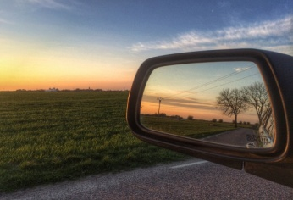
Stages of Reflection
Schön (1983)
Reflection FOR action
Planning for the piece
of work before it happens
What might happen, what will work best, and how to handle issues that may arrive
Reflection IN action
Reflecting at the moment
it is happening and adapting
approach to what works best at that time
Reflection ON action
Looking back after the fact, how things went good
and bad,
did “in action” affect the outcomes?
How could it have been better?
DIEP Strategy
Boud (1985) adapted by RMIT University (2007)
Describe
What happened?
Interpret
How do I feel it went?
Evaluate
What was good?
Plan
What can I do differently in the future?
What did I do?
What did other people do?
What Ideas did I draw on?
How did I apply my ideas?
What was not so good?
Is there anything that worked particularly well?
Why?
What have I learnt?
How can I action my learning?
What Support do I need to do this?
What you saw, heard and learnt
What was the value of this experience?

Slide 3
What? So What?
Now What?
Borton (1970)
What?
What happened?
What did I do?
What did others do?
What was I trying to Achieve?
What was actually achieved?
What was my reaction?
So What?
So what are my feelings now
So what were the effects of my actions?
So what is the importance of this?
So what more do I know?
So What have I learnt?
Now What?
Now what do I need to do?
Now what different options have I got ?
Now what help do I need to action my reflection and learning?
S W O T Analysis
SWOT Analysis is an evaluation tool that allows you to reflect and form a decision. This tool is often used in the business world and can be applied to many topics
Now What?
So What?
What?
Strengths
Capabilities, resources, advantages, personal strengths, support networks,
Weaknesses
Areas not so good at, limited resource, things to change, new skills you need to develop
Opportunities
Build on strengths, support network, external factors to benefit
Threats
Obstacles, impending change, What would cause failure?

Slide 4
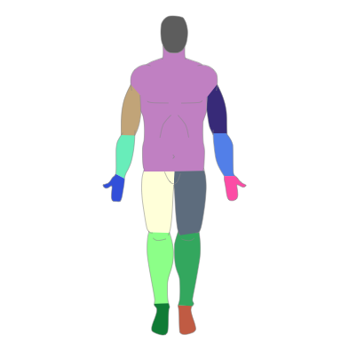
Environment – What do I encounter?
What am I dealing with? What impact does the environment have on the situation and practice?
Behaviour – What did I do? How did I behave? How was my behaviour viewed by others?
Competencies- What am I competent at? Is there anything further I need to develop? Is there criteria for standards? Did I meet these standards?
Beliefs- What do I believe?
What impact do values and beliefs
have on my practice?
Identity – Who Am I? How do people see me?
who else is involved? What are similarities/
differences between us?
Mission –What inspires me?
Why am I a social worker? To what extent is that mission evident in what I do?
Head, Heart, Hands and Feet
Head: What Knowledge and experiences did you draw on?
Heart: How did you feel? How did the child / family feel?
motivation or intention
Hands: What did you do? How did you do it? What skills did you use?
Competencies
Identity
Mission
Behaviour
Beliefs
Environment
Feet:
How did your profession and practice standards ground your practice? E.g. Values?
The Onion
Model
Korthagen (2015)

Slide 5


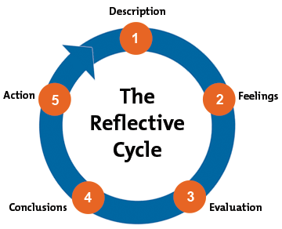
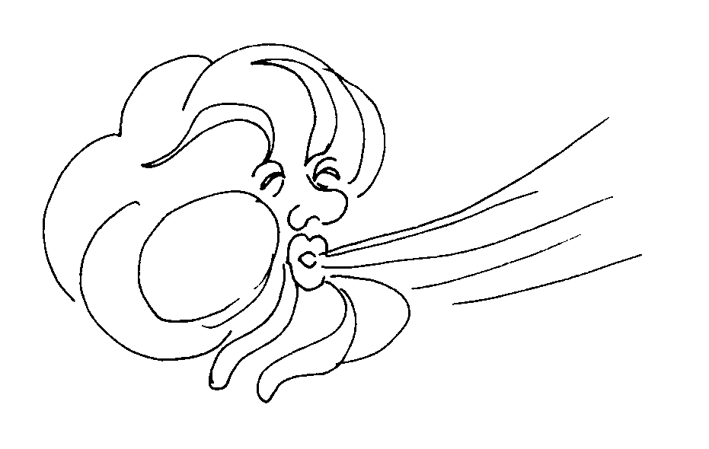
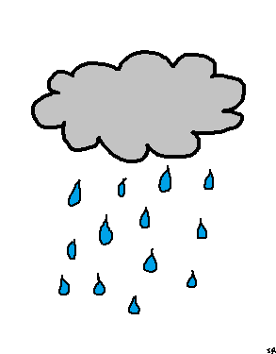


The Weather Model
Gibb’s Reflective Cycle
What? Where? Who? Why? What?
Sunshine what went well? Feeling good?
What were you thinking and feeling at the time?
Cloudy/Foggy
Doing ok? but could go wrong? unsure of where to go?
How are you going to apply your learning?
Wind
Is something blowing you off course?
What would you do differently next time?
How did your feelings impact on what happened?
Rain
What didn’t go
so well?
Thunder and Lightening
To many voices not able to see the true picture? A voice missing? Has there been any surprises?
Stormy:
Is there a lot of conflict? Disagreements or lack of engagement? How did you manage the storm?
What have you learnt? What else could you have done?
What went well and what didn’t go so well?
Consider Power – Who is forecasting the weather?

