Slide 1
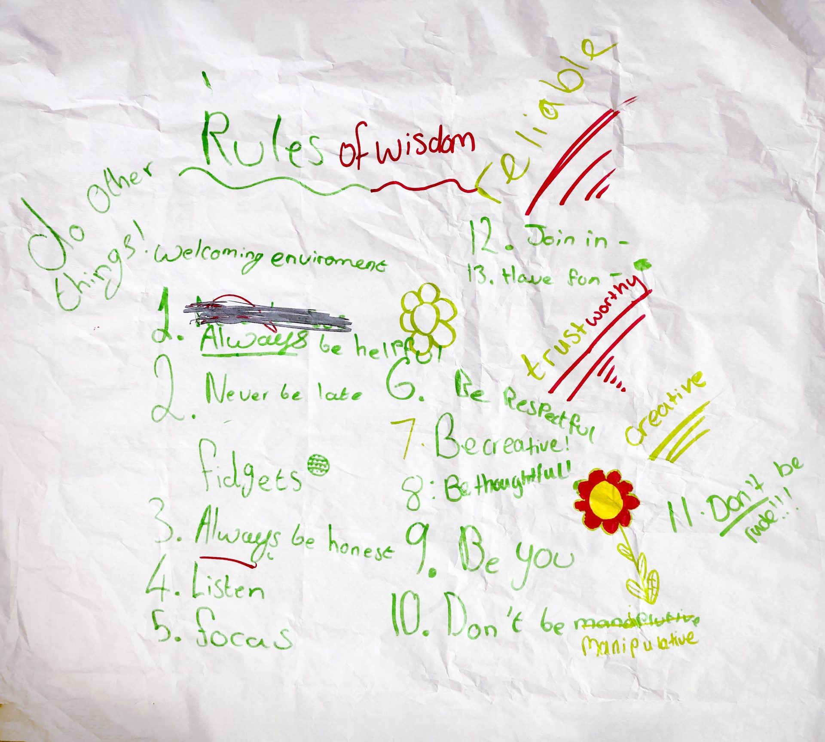
Bringing Young People’s Voices into Social Work Qualifying and Post-Qualifying Courses
Hannah Harrison, Dr Peter Unwin and Kirsty Fraser
Introduction
An integral part of effective Social Work practice is the ability of the practitioner to engage and create a successful working relationship with service users (Franklin et al. 2016). To achieve this, a commitment to increasing awareness and understanding of practice from the Service Users perspective is vital, and the foundations of this can often be found in the accredited courses offering Social Work Qualifications. Despite the increased understanding and appreciation of the value of Service User input in Social Work Higher Education courses (MacAlister, 2022), it remains apparent that there is a lack of Young Persons Voice being represented amongst these forums.
At a time when research is showing Social workers are struggling to engage effectively with Children and Young People (Ruch et al., 2020), and despite research presenting further opportunities including the use of social media to engage with Young People (Franklin et al, 2016: Lucas and Thomas, 2020), it appears that this absence in representation is creating a gap within the knowledge of those newly qualified, instead leaning towards a solely task orientated approach to their communications (Ruch et al., 2020: O’Shea and Mcginnis, 2020).
Approval and Quantitative Research
We gained ethical approval from the University of Worcester and ensured information pertaining to the participation of children and young People was age appropriate e.g., we produced a short video about the project and what participation would involve, sending this out before a focus group of children and young people was held. We sought to explore the realities behind the ‘accepted wisdom/ (non) custom and practice regarding involvement being adult-only .A systematic search was then conducted of each of these universities’ web pages, with 3/89 universities whose websites indicated at least some inclusion of children and young people in their social work courses, hoping they would be willing to discuss their experiences. The three examples found were ad hoc, and not systematic. Only one of the universities responded to our invitation to discuss their profile further, and this contact was most informative, stating that key factors for success were building mutually beneficial relationships and offering children and young people the chance to increase their autonomy and skills. It was highlighted that, for a successful partnership, the young person must feel that their participation holds value and worth and that they are not a token inclusion.
Findings and Future Developments
The social work profession is constantly being exhorted to bring systems, rather than incremental, change to its Children’s Services (Munro,2012 ; Featherstone et al., 2018; MacAlister, 2022) and the findings of this project offer a credible option for bringing about such change. We intend to produce an academic article from this work and intend to share it within the relevant Partnership committees and wider. We intend to contact Social Work England and request that they consider mandating the involvement of children and young people in qualifying social work courses , as is the (funded) case with adults . We will be using the University of Worcester’s platforms within the Partnership to introduce children and young people into their curriculum, research, interviewing and quality operations. Possibly, a pilot study could be taken in the region to measure impact over, say, one academic year.
Qualitative Research- Focus Group
Additionally, after the web trawl, we held a focus group of children and young people currently in care, together with care leavers and support staff. The two young people present who had prior experience of HEI involvement expressed there had so far been no negative repercussions for their involvement with collaborative working with professionals, and all in the focus group agreed that, in the words of one young person, it “definitely should happen, what young people see is different from what adults may see’.
Further points raised were that young people and students alike must benefit from the experience, and each occurrence must be delivered with open-mindedness from all sides. The participants highlighted specific issues they have found within their own lived experiences, such as social workers arriving late, or cancelling meetings, the inability to contact their social worker, and the use of language, terminology and/or communication styles that left the young person looking to their carers to translate what had been said to them. It was their hope that an increased representation of young people in social work education would rectify these shortfalls in practice.
13 Rules of Wisdom
1. Always be Helpful
2. Never Be Late
3. Always be Honest
4. Listen and Focus
5. Be Respectful
6. Be Creative
7. Be Thoughtful
8. Be You
9. Don’t be Manipulative
10. Don’t be Rude
11. Join in
12. Have Fun
13. Be Mindful of Mental Health.
References
Complete University Guide (2023). Social Work subject League Table 2023. Available at: https://www.thecompleteuniversityguide.co.uk/league-tables/rankings/social-work. (Accessed 17 January 2023)
Corney. T., Copper. T., Shier. H., Williamson. H. (2022) ‘Youth Participation: Adultism, Human rights and professional Youth Work. Available at: https://onlinelibrary.wiley.com/doi/abs/10.1111/chso.12526. (Accessed 17 January 2023)
Franklin, P., Hossain, R. and Coren, E. (2016) Social media and young people’s involvement in social work education. Social Work Education, 35 (3). pp. 344-356. ISSN 0261-5479
Lucas, S.E. and Thomas, N. (2021) ‘Listening to care experienced young people and creating audio-bites for social work education’, Social Work Education, 40(7), pp. 915–927. Available at: https://doi.org/10.1080/02615479.2020.1762857.
McLaughlin, H. (2010) ‘Keeping Service User Involvement in Research Honest’, The British Journal of Social Work, 40(5), pp. 1591–1608. Available at: https://doi.org/10.1093/bjsw/bcp064.
McLaughlin. H. (2006) ‘Involving Young Service Users as Co-Researchers: Possibilities, Benefits and Costs’. Available at: https://doi.org/10.1093/bjsw/bch420. ( Accessed 23 January 2023)
O’Shea, J. and McGinnis, E. (2020) ‘“Do you really want me to tell ya!” critical learning in engaging young people in contact with the justice system as peer
educators with social work students’, Social Work Education, 39(6), pp. 706–720. Available at: https://doi.org/10.1080/02615479.2019.1663813.
Participation People (2020) ‘Rewarding, Recognising and Incentivising Young Peoples Volunteering’. Available at: PP | Young People Incentives POLICY 2020 (participationpeople.com). (Accessed 26 March 2023)
Participation Works. (2009) ‘How to: Renumerate and Reward Children and Young People’s Involvement’. Available at: _Layout 1 (yor-ok.org.uk). (Accessed 26 March 2023)
Rogers, R. (2011) ‘“I remember thinking, why isn’t there someone to help me? Why isn’t there someone who can help me make sense of what I’m going through?”: “Instant adulthood” and the transition of young people out of state care’, Journal of Sociology, 47(4), pp. 411–426. Available at: https://doi.org/10.1177/1440783311420793.
Ruch. G., Winter. K., Morrison. F., Hadfield. M., Hallett. S., Cree. V. (2020). ‘From Communication to co-operation: Reconceptualising social worker’s engagement with children’. Available at: https://onlinelibrary.wiley.com/doi/10.1111/cfs.12699 . ( Accessed 25 March 2023)
Tanner, D., Littlechild. R., Duffy. J., Hayes. D. (2017) ‘“Making It Real”: Evaluating the Impact of Service User and Carer Involvement in Social Work Education’, The British Journal of Social Work, 47(2), pp. 467–486. Available at: https://doi.org/10.1093/bjsw/bcv121.

